Slide 1

CHAPTER 6:
VIEWING IN 2D

Slide 2
CONTENTS
Windowing Concepts
Clipping
  Introduction
  Brute Force
  Cohen-Sutherland Clipping Algorithm
Area Clipping
  Sutherland-Hodgman Area Clipping Algorithm

Slide 3
WINDOWING I
A scene is made up of a collection of objects specified in world coordinates
World Coordinates

Slide 4
WINDOWING II
When we display a scene only those objects within a particular window are displayed
Window
wy_{max}
wy_{min}
wx_{min}
wx_{max}
World Coordinates

Slide 5
WINDOWING III
Because drawing things to a display takes time, we clip everything outside the window
Window
wy_{max}
wy_{min}
wx_{min}
wx_{max}
World Coordinates

Slide 6
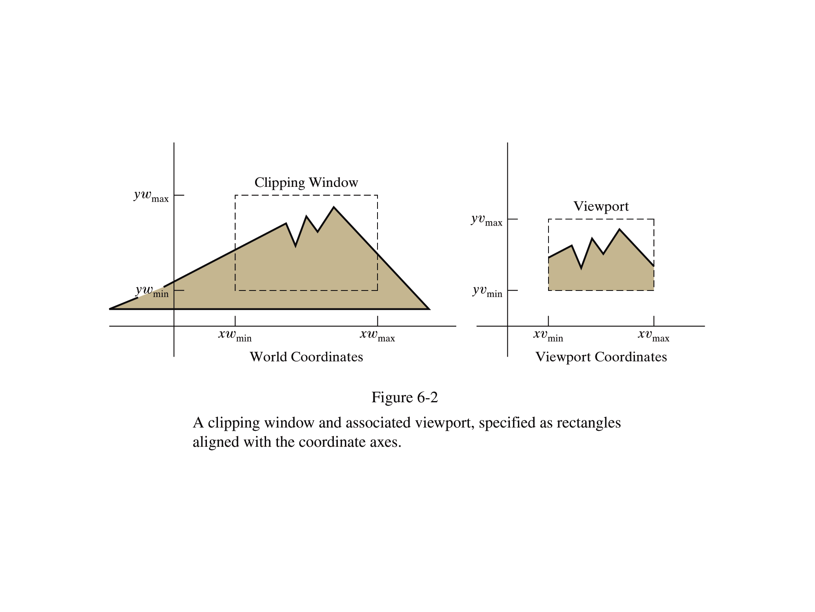
WINDOW VS. VIEWPORT
Window
  World-coordinate area selected for display
  What is to be viewed
Viewport
  Area on the display device to which a window is mapped
  Where it is to be displayed

Slide 7
VIEWPORT TRANSFORMATION
y_{wmax}
Window
Normalization
Viewport
y_{vmax}
(x_{w}, y_{w})
(x_{v}, y_{v})
y_{wmin}
y_{vmin}
x_{wmin}
x_{wmax}
x_{vmin}
x_{vmax}
Screen Coordinates
Image Coordinates
x_{v} = x_{vmin} + (x_{w} – x_{wmin}) * (x_{vmax}– x_{vmin}) / (x_{wmax}– x_{wmin})
y_{v} = y_{vmin} + (y_{w}– y_{wmin}) * (y_{vmax}– y_{vmin}) / (y_{wmax}– y_{wmin})

Slide 8
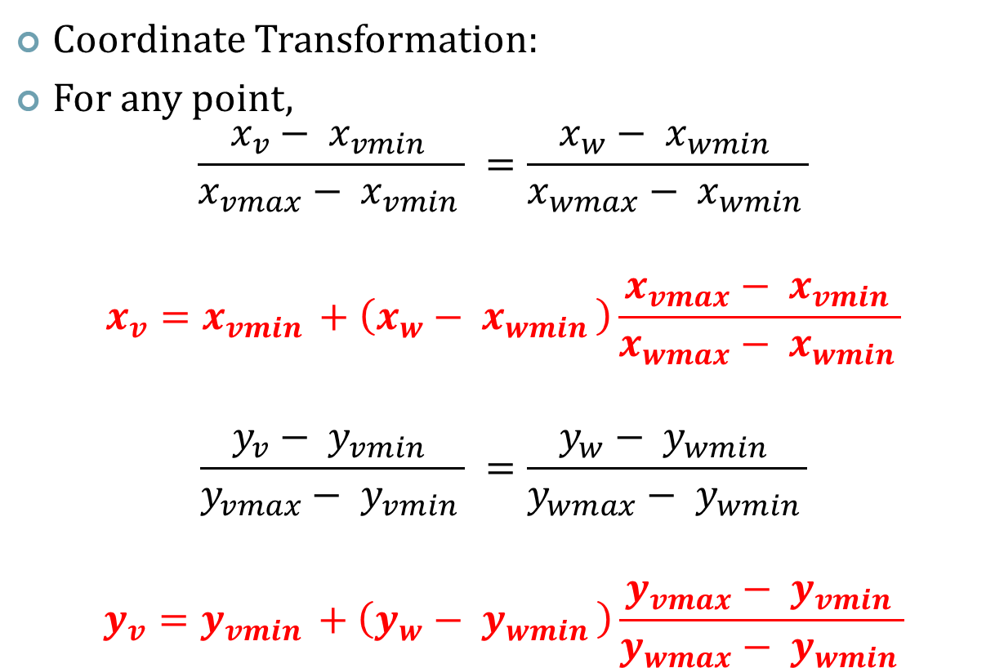
WORLD COORDINATES TO VIEWING PORT COORDINATES

Slide 9
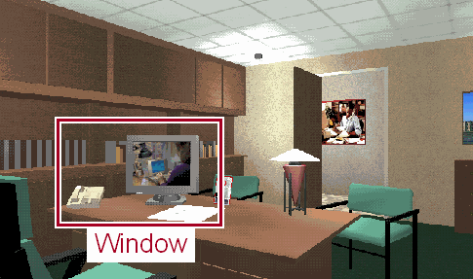
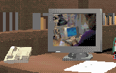
CLIPPING
Avoid Drawing Parts of Primitives Outside Window
Image
Viewport
Screen
World Coordinates

Slide 10
POINT CLIPPING
Is Point(x,y) Inside the Clip Window?
P₄
Clipped
Clipped
Window
P₂
Inside :
(x>= x_{wmin}) &&
(x<= x_{wmax}) &&
(y>= y_{wmin}) &&
(y<= y_{wmax})
wy_{max}
Clipped
P₅
P₇
P₁
Points Within the Window are Not Clipped
P₉
P₈
wy_{min}
Clipped
P₁₀
wx_{min}
wx_{max}

Slide 11
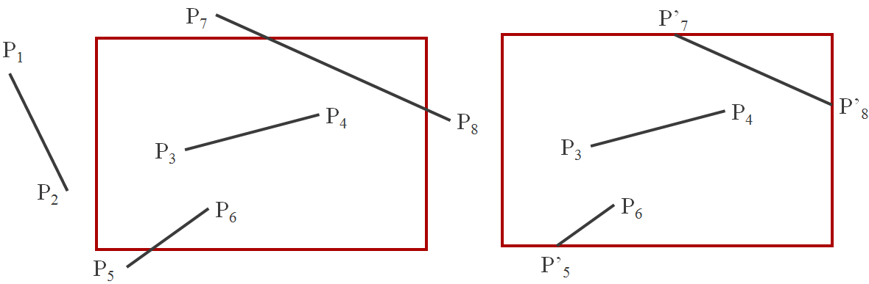
LINE CLIPPING
For the image below consider which lines and points should be kept and which ones should be clipped.
Before Clipping
After Clipping

Slide 12
LINE CLIPPING
Harder - examine the end-points of each line to see if they are in the window or not
Situation | Solution | Example
Both end-points inside the window | Don’t clip
One end-point inside the window, one outside | Must clip
Both end-points outside the window | Don’t know!

Slide 13
BRUTE FORCE LINE CLIPPING
Brute force line clipping can be performed as follows:
  For lines with both end-points
  within the window→ Don’t clip
  For lines with one end-point inside
  the window and one end-point
  Outside→ calculate the intersection point
  (using the equation of the line) and clip from this point out
  For lines with both end-points outside the window→ test the line for intersection with all of the window boundaries, and clip appropriately

Slide 14
INTERSECTION POINTS
Intersection points (x, y) of a line of endpoints p₁(x₁, y₁) and p₂(x₂, y₂):
  Vertical Intersection
    y = y₁ + m(x - x₁)
    x = x_{wmin} or x_{wmax}
  Horizontal Intersection
    x = x₁ + (y - y₁)/m
    y = y_{wmin} or y_{wmax}

Slide 15
BRUTE FORCE LINE CLIPPING (CONT…)
The brute force algorithm is much too slow
calculating line intersections is computationally expensive, because a scene can contain so many lines
Cohen-Sutherland clipping algorithm: an efficient line clipping algorithm
The key advantage is that it vastly reduces the number of line intersections that must be calculated

Slide 16
COHEN-SUTHERLAND: WORLD DIVISION
World space is divided into regions based on the window boundaries
  Each region has a unique four bit region code
  Region codes indicate the position of the regions with respect to the window
1001 | 1000 | 1010
0001 | 0000 Window | 0010
0101 | 0100 | 0110
3
2
1
0
above
below
right
left
Region Code Legend

Slide 17
LINE CLIPPING
Use Simple Tests to Classify Easy Cases First
Divide the area into regions represented by Bit Codes, and give each endpoint a bit code.
1001
P₇
1000
1010
Bit 4
P₁
P₄
P₈
0001
P₃
0010
0000
P₂
P₆
Bit 3
0101
P₅
0100
0110
Bit 1
Bit 2

Slide 18
LINE CLIPPING
If both endpoints has the bit value ‘1’ in the same bit position, then the line is completely outside
1001
P₇
1000
1010
Bit 4
P₁
P₄
P₈
0001
P₃
0000
0010
P₂
P₆
Bit 3
0101
P₅
0100
0110
Bit 1
Bit 2

Slide 19
LINE CLIPPING
If both endpoints has the bit code 0000, then the line is completely inside
1001
P₇
1000
1010
Bit 4
P₄
P₈
0001
P₃
0000
0010
P₆
Bit 3
0101
P₅
0100
0110
Bit 1
Bit 2

Slide 20
LINE CLIPPING
Otherwise, Compute Intersections with Window Boundary for Lines
1001
P₇
1000
1010
Bit 4
P₄
P₈
0001
P₃
0000
0010
P₆
Bit 3
0101
P₅
0100
0110
Bit 1
Bit 2

Slide 21
COHEN-SUTHERLAND: OTHER LINES
Lines that cannot be identified as completely inside or outside the window may or may not cross the window interior
These lines are processed as follows:
  Compare an end-point outside the window to a boundary (choose any order in which to consider boundaries e.g. left, right, bottom, top) and determine how much can be discarded
  If the remainder of the line is entirely inside or outside the window, retain it or clip it respectively

Slide 22
COHEN-SUTHERLAND: OTHER LINES (CONT…)
  Otherwise, compare the remainder of the line against the other window boundaries
  Continue until the line is either discarded or a segment inside the window is found
We can use the region codes to determine which window boundaries should be considered for intersection
  To check if a line crosses a particular boundary we compare the appropriate bits in the region codes of its end-points
  If one of these is a 1 and the other is a 0 then the line crosses the boundary

Slide 23
LINE CLIPPING
1001
P₇
1000
1010
Bit 4
P₄
P₈
0001
P₃
0000
0010
P₆
Bit 3
0101
P₅
0100
0110
Bit 1
Bit 2

Slide 24
LINE CLIPPING
1001
P₇
1000
1010
Bit 4
P₄
P₈
0001
P₃
0000
0010
P₆
Bit 3
P’₅
0101
0100
0110
Bit 1
Bit 2

Slide 25
LINE CLIPPING
1001
P₇
1000
1010
Bit 4
P₄
P₈
0001
P₃
0000
0010
P₆
Bit 3
P’₅
0101
0100
0110
Bit 1
Bit 2

Slide 26
LINE CLIPPING
1001
1000
P’₇
1010
Bit 4
P₄
P’₈
0001
P₃
0000
0010
P₆
Bit 3
P’₅
0101
0100
0110
Bit 1
Bit 2

Slide 27
LINE CLIPPING
1001
1000
P’₇
1010
Bit 4
P₄
P’₈
0001
P₃
0000
0010
P₆
Bit 3
P’₅
0101
0100
0110
Bit 1
Bit 2

Slide 28
COHEN-SUTHERLAND EXAMPLES
Consider the line P₉ to P₁₀ below:
  Start at P₁₀
  From the region codes of the two end-points we know the line doesn’t cross the left or right boundary
  Calculate the intersection of the line with the bottom boundary to generate point P₁₀’
  The line P₉ to P₁₀’ is completely inside the window so is retained
Window
wy_{max}
P₉ [0000]
P₉ [0000]
wy_{min}
P₁₀’ [0000]
P₁₀ [0100]
wx_{min}
wx_{max}

Slide 29
COHEN-SUTHERLAND EXAMPLES
Consider the line P₇ to P₈
  Start at P₇
  From the two region codes of the two end-points we know the line crosses the left boundary so calculate the intersection point to generate P₇’
Window
wy_{max}
P₇’ [0000]
P₇ [0001]
P₈’ [0000]
P₈ [0010]
wy_{min}
wx_{min}
wx_{max}

Slide 30
COHEN-SUTHERLAND EXAMPLES
Consider the line P₇’ to P₈
  Start at P₈
  Calculate the intersection with the right boundary to generate P₈’
  P₇’ to P₈’ is inside the window so is retained
Window
wy_{max}
P₇’ [0000]
P₇ [0001]
P₈ [0010]
P₈’ [0000]
wy_{min}
wx_{min}
wx_{max}

Slide 31
AREA CLIPPING
Similarly to lines, areas must be clipped to a window boundary
Consideration must be taken as to which portions of the area must be clipped

Slide 32
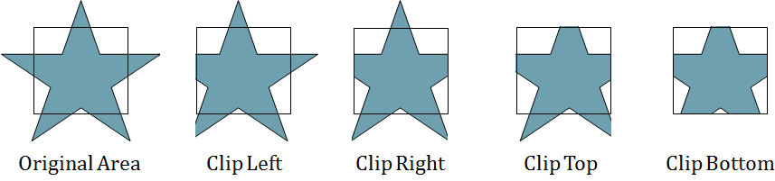
SUTHERLAND-HODGMAN AREA CLIPPING ALGORITHM
A technique for clipping areas developed by Sutherland & Hodgman
Put simply the polygon is clipped by comparing it against each boundary in turn

Slide 33
SUTHERLAND-HODGMAN AREA CLIPPING ALGORITHM (CONT…)
To clip an area against an individual boundary:
  Consider each vertex in turn against the boundary
  Vertices inside the boundary are saved for clipping against the next boundary
  Vertices outside the boundary are clipped
  If we proceed from a point inside the boundary to one outside, the intersection of the line with the boundary is saved
  If we cross from the outside to the inside intersection point and the vertex are saved

Slide 34
CASE 1: BOTH V₁ & V₂ OUT
OUT
IN
Out→ OUT
Action: nothing
V₁
Polygon
being
clipped
V₂
Clip boundary
Notes:
Utah School of Computing
Spring 05
Computer Graphics CS5600

Slide 35
CASE 2: BOTH V₁ & V₂ IN
OUT
IN
V₂
IN→ IN
Action: save V₂
V₁
Notes:
Utah School of Computing
Spring 05
Computer Graphics CS5600

Slide 36
CASE 3: V₁ IN & V₂ OUT
OUT
IN
V₁
IN→ OUT
Action: save V₁’
V₂
V₁’
Notes:
Utah School of Computing
Spring 05
Computer Graphics CS5600

Slide 37
CASE 4: V₁ OUT & V₂ IN
OUT
IN
Out→ IN
Action: save V₁’ V₂
V₂
V₁
V₁’
Notes:
Utah School of Computing
Spring 05
Computer Graphics CS5600

Slide 38
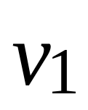
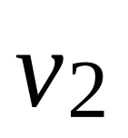

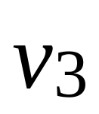
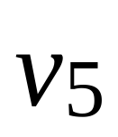
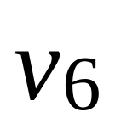
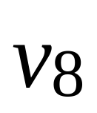

HODGEMAN-SUTHERLAND
Notes:
Utah School of Computing
Spring 05
Computer Graphics CS5600

Slide 39
HODGEMAN-SUTHERLAND
Notes:
Utah School of Computing
Spring 05
Computer Graphics CS5600

Slide 40

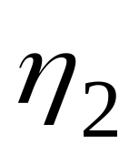
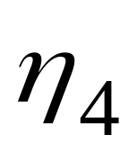
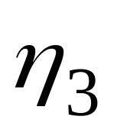
HODGEMAN-SUTHERLAND: TOP
Notes:
Utah School of Computing
Spring 05
Computer Graphics CS5600

Slide 41
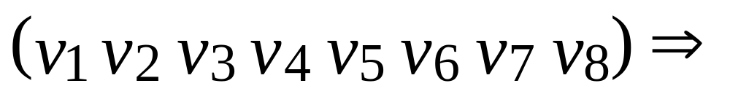
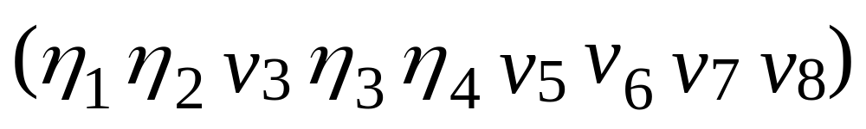
HODGEMAN-SUTHERLAND:TOP
Notes:
Utah School of Computing
Spring 05
Computer Graphics CS5600

Slide 42
HODGEMAN-SUTHERLAND: BOTTOM
Notes:
Utah School of Computing
Spring 05
Computer Graphics CS5600

Slide 43
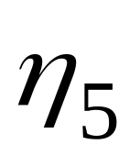
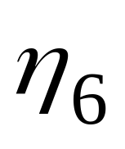
HODGEMAN-SUTHERLAND: BOTTOM
Notes:
Utah School of Computing
Spring 05
Computer Graphics CS5600

Slide 44
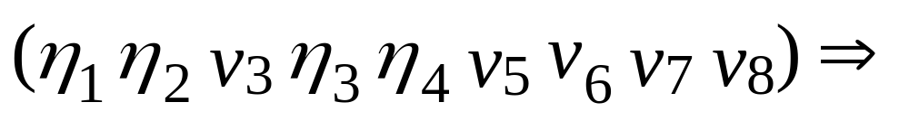
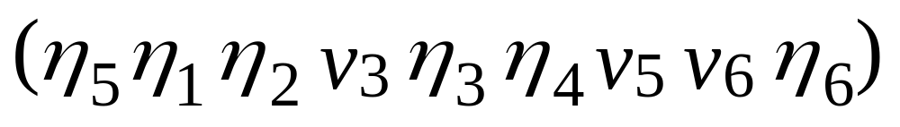
HODGEMAN-SUTHERLAND: BOTTOM
Notes:
Utah School of Computing
Spring 05
Computer Graphics CS5600

Slide 45
HODGEMAN-SUTHERLAND: RIGHT
Notes:
Utah School of Computing
Spring 05
Computer Graphics CS5600

Slide 46
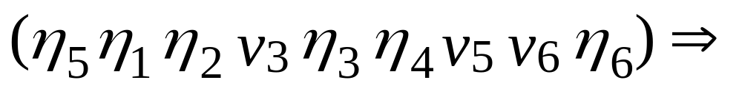
HODGEMAN-SUTHERLAND: RIGHT
This case is trivial: do nothing
Notes:
Utah School of Computing
Spring 05
Computer Graphics CS5600

Slide 47
HODGEMAN-SUTHERLAND: LEFT
Notes:
Utah School of Computing
Spring 05
Computer Graphics CS5600

Slide 48

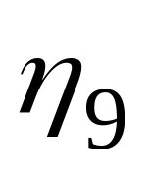
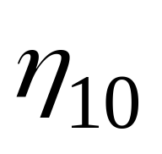
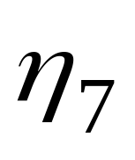
HODGEMAN-SUTHERLAND: LEFT
Notes:
Utah School of Computing
Spring 05
Computer Graphics CS5600

Slide 49
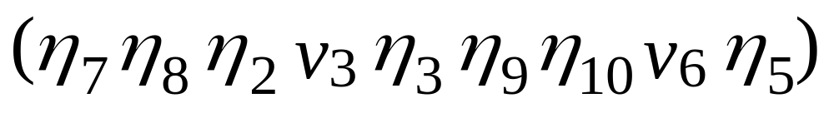
HODGEMAN-SUTHERLAND: LEFT
Notes:
Utah School of Computing
Spring 05
Computer Graphics CS5600

Slide 50
HODGEMAN-SUTHERLAND: DONE
Extra Lines
Notes:
Utah School of Computing
Spring 05
Computer Graphics CS5600

Slide 51



EXTENDED H-S ALGORITHM
Tag the different new vertices
Call the one generated on transition from IN to OUT
Call the one generated on transition from OUT to IN
Starting from OUT, connect as soon as is generated

Slide 52

EXAMPLE OF H-S ALGORITHM
OUT
IN

Slide 53
HODGEMAN-SUTHERLAND: DONE
Notes:
Utah School of Computing
Spring 05
Computer Graphics CS5600

Slide 54
SUTHERLAND-HODGMAN EXAMPLE
P
S
S
P
I
P
S
Save Point I
No Points Saved
Save Point P
S
I
P
Save Points I & P

Slide 55
WEILER-ATHERTON POLYGON CLIPPING
Another approach to polygon clipping
No extra clipping outside window
Works for arbitrary shapes
Avoids degenerate polygons

Slide 56
WEILER-ATHERTON CLIPPING
Start at first (inside) vertex
Traverse polygon until hitting a window boundary
Output intersection point i
Turn right
Follow window boundary until next intersection
Output second intersection
Turn right, again, and follow subject polygon until closed
Continue on subject polygon from first intersection point.
Repeat processing until complete

Slide 57
WEILER-ATHERTON CLIPPING
13
14
4
2
3
5
1
12
6
9
Clip
Polygon (ep)
7
Subject Polygon
(sp)
8
10
11
Notes:
Utah School of Computing
Spring 05
Computer Graphics CS5600

Slide 58
WEILER-ATHERTON CLIPPING
Notes:
Utah School of Computing
Spring 05
Computer Graphics CS5600

Slide 59
OTHER AREA CLIPPING CONCERNS
Clipping concave areas can be a little more tricky as often superfluous lines must be removed .
Clipping curves requires more work, e.g., for circles we must find the two intersection points on the window boundary.

Slide 60
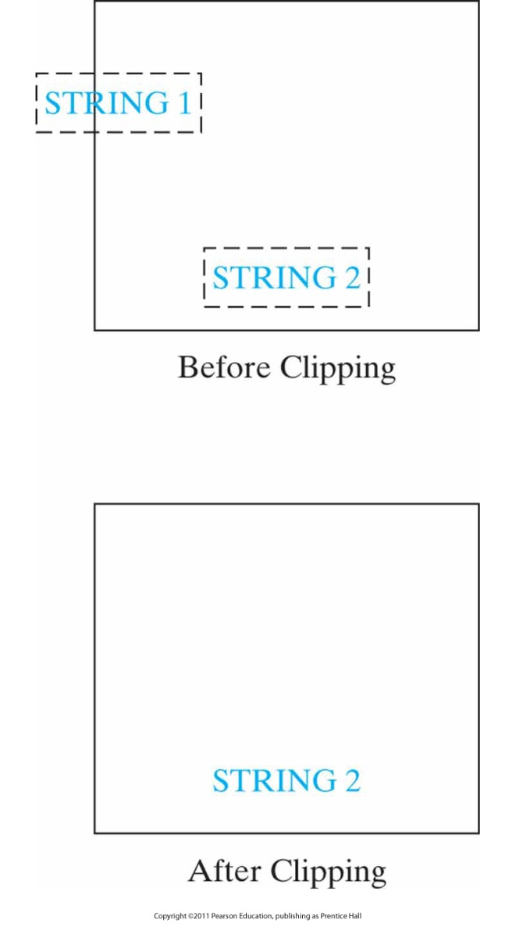
TEXT CLIPPING
All-or-None String Clipping

Slide 61
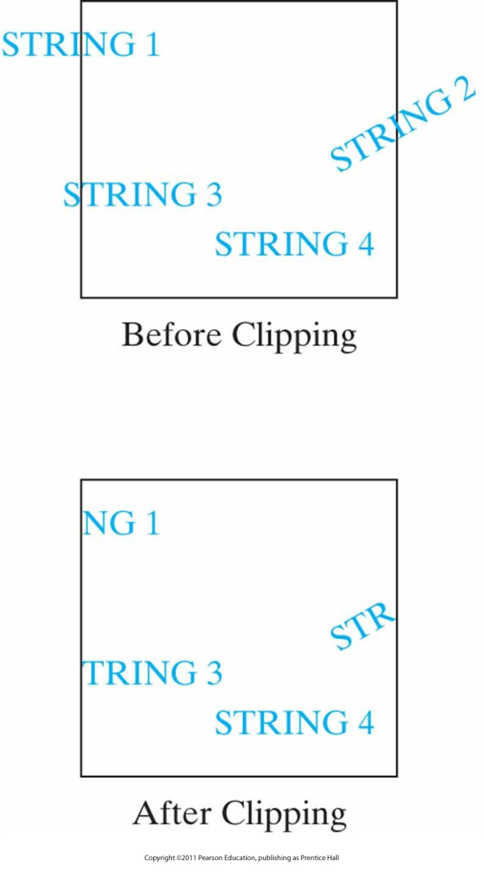
TEXT CLIPPING
All-or-None Character Clipping

Slide 62
End of Chapter

